Slide 1
Category review: Chips
June 2020
Retail Analytics
Brand note: If client logo is not required, use alternate title page layout right click slide thumbnail > Layout > Title

Slide 2
Notes:
To view Privacy video explaining how important data privacy is to Quantium, please click here: https://www.youtube.com/watch?v=Zq1QDAkoRzU
or here Q:\Company Reference\Brand & Design\Brand videos\Q Privacy.mp4
At Quantium, we believe that data is the behavioural footprint of humanity and that it has to be treated with the utmost care and responsibility.
Histories, attitudes, indeed lives are stored within it in ways that aren’t always apparent – and that’s what makes its potential so powerful.
To work with it responsibly, sensitively, we set ourselves the highest data privacy protection and governance standards.
We have spent 17 years perfecting privacy-by-design and secure-by-design principles. Central to this is not holding any personally identifiable information about people –
we neither receive it, and put the necessary protections in place to be unable to decipher it.
Every aspect of handling data is safeguarded: from its de-identification, to its encryption – data security is paramount and of the highest grade.
We pride ourselves on gaining the trust of iconic organisations around the world through years of securely working with their data,
and in turn the trust that builds with their stakeholders.

Slide 3
Executive summary
01
Task 1
Data preparation and customer analytics
02
Task 2
Experimentation and uplifting testing

Slide 4
01
Category

Slide 5
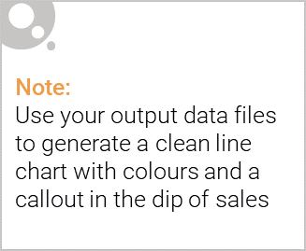
Overview: your key callout for the category should be included here
Mainstream midage and young singles and couples are more willing to pay more per packet of chips compared to their budget and premium counterparts. This may be due to premium shoppers being more likely to buy healthy snacks and when they buy chips, this is mainly for entertainment purposes rather than their own consumption. This is also supported by there being fewer premium midage and young singles and couples buying chips compared to their mainstream counterparts.
The t-test results in a p-value of 0.03256, i.e. the unit price for mainstream, young and mid-age singles and couples are significantly higher than that of budget or premium, young and midage singles and couples.

Slide 6

This slide will be commentary on affluence and its effect on consumer buying for the category of chips
We have found quite a few interesting insights that we can dive deeper into. We might want to target customer segments that contribute the most to sales to retain them or further increase sales. The most popular brands and pack sizes are below:
Brand Count
Kettle 5633
Pringles 3463
Smiths 3295
Doritos 3069
Infzns 1887
Thins 1792
RRD 1321
Cobs 1318
Twisties 1317
Tostitos 1314
Size Count
175 8171
150 5084
134 3463
110 3061
170 2591
165 1930
330 1755
270 914
380 909
210 839

Slide 7
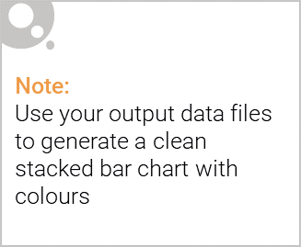
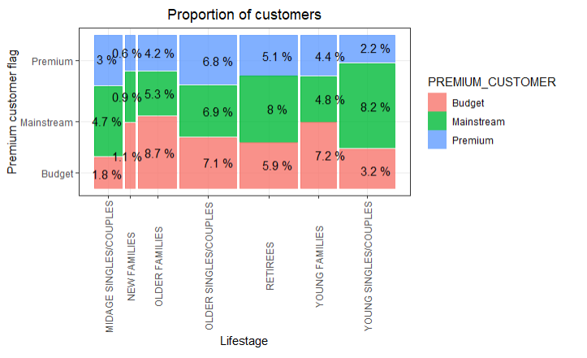
Editable (delete this)
Stretch: Try visualising the proportion of customers by affluence and life stage on this slide

Slide 8
02
Trial store performance

Slide 9
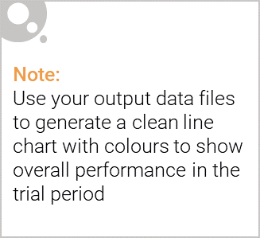
Explanation of the control store vs other stores
The client has selected store numbers 77, 86 and 88 as trial stores and want control stores to be established stores that are operational for the entire observation period.
We would want to match trial stores to control stores that are similar to the trial store prior to the trial period of Feb 2019 in terms of :
- Monthly overall sales revenue
- Monthly number of customers
- Monthly number of transactions per customer

Slide 10
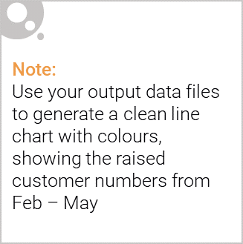
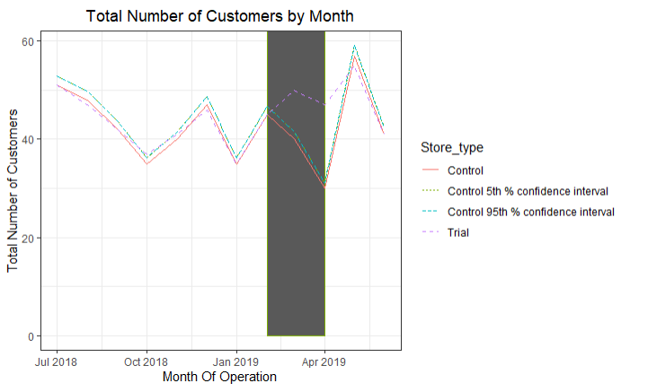
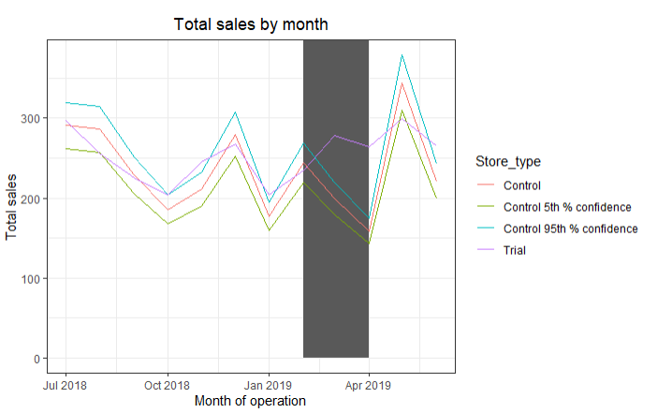
Call out of the performance in the trial store, determining if it was successful

